Slide 1


APISERO
NEXT GENERATION
CONSULTING SERVICES
The content of this presentation is proprietary and confidential information of Apisero, Inc. This presentation
is not intended to be distributed to any third party without the prior written consent of Apisero, Inc.

Slide 2
Agenda
Description of Use Case
Database Schema
Ramls
Implementation - Flows and Configuration files
Error Handling
Wrap Up

Slide 3
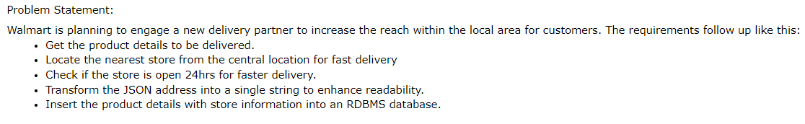
Overview of Use Case:

Slide 4
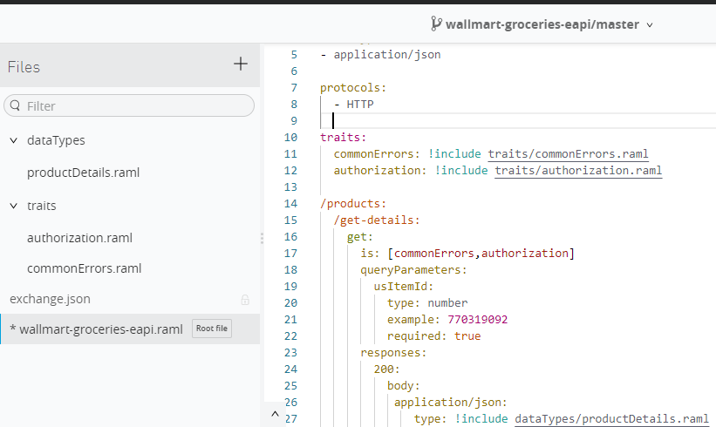
RAML(Experience API)

Slide 5
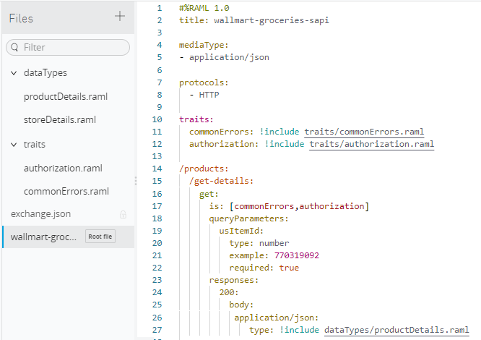
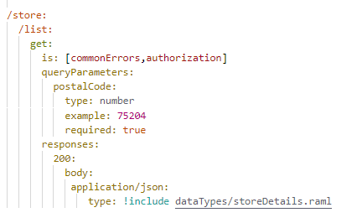
RAML (Process api)

Slide 6
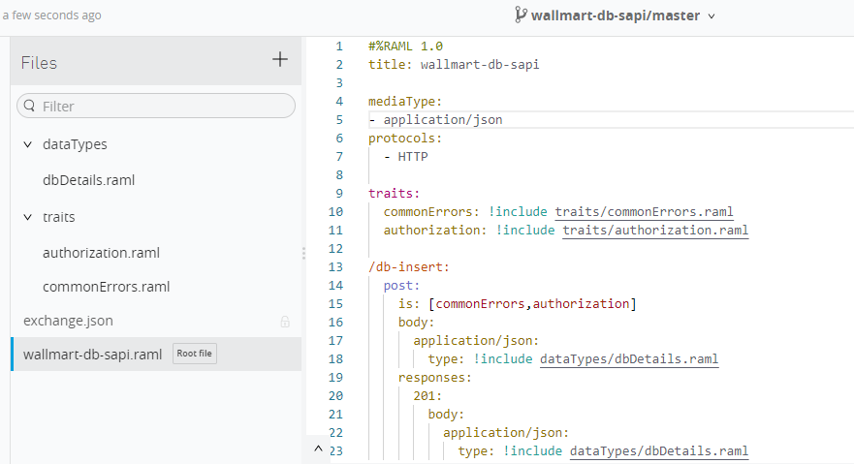
RAML (System api)

Slide 7
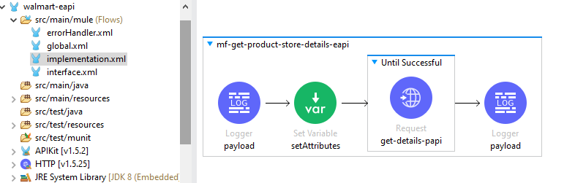
Implementation Flow- (Experience Api)

Slide 8
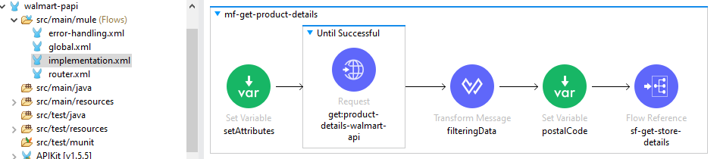
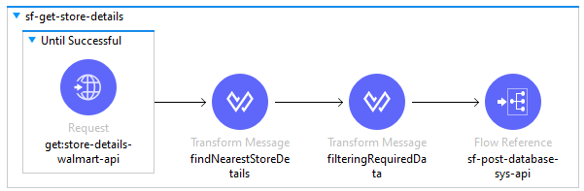
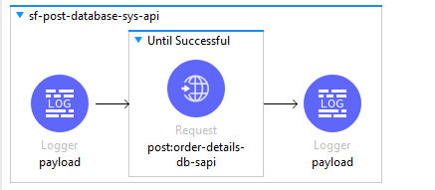
Implementation Flow- (Process Api)

Slide 9
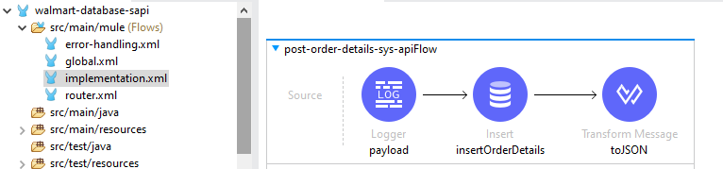
Implementation Flow- (System api)

Slide 10
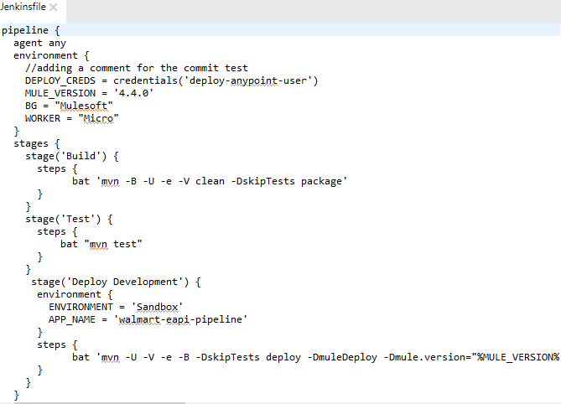
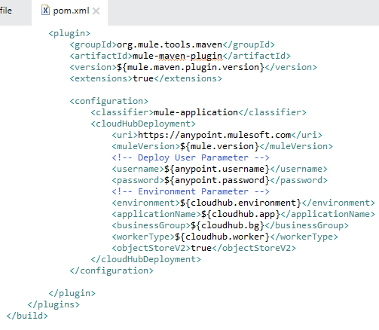
CI/CD

Slide 11
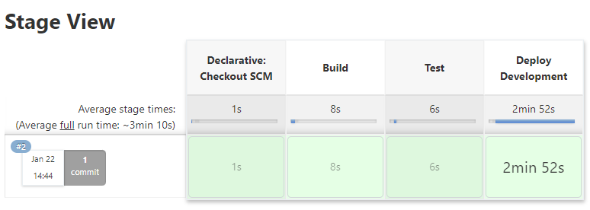
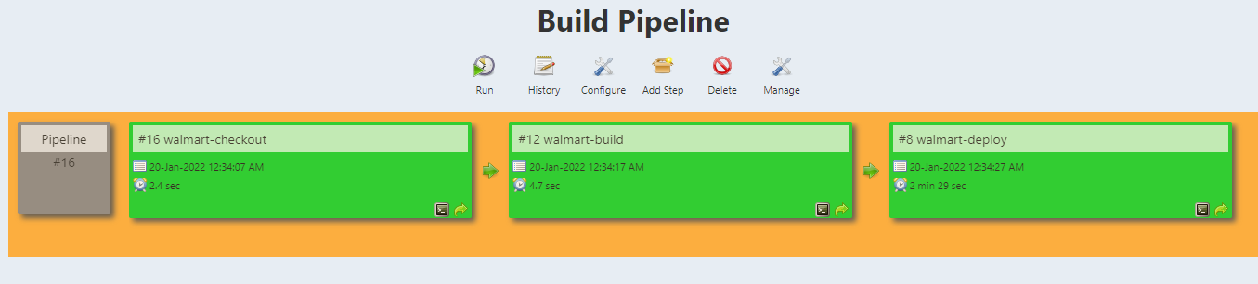

Slide 12
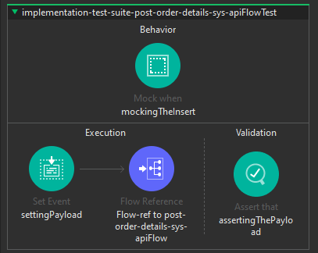
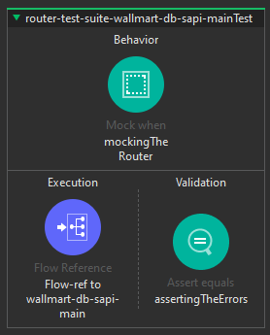
MUnits

Slide 13
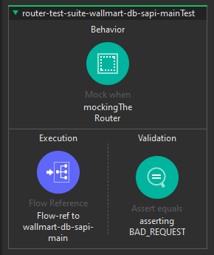
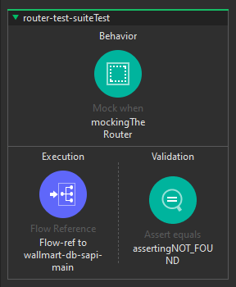
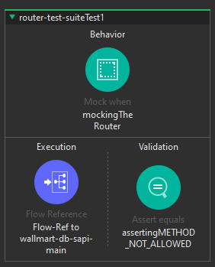
MUnits

Slide 14
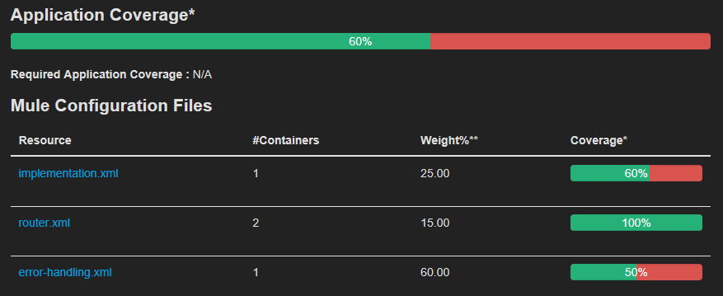
MUnits

